Slide 1



Starting Now
Building Knowledge Graphs to Enable Agentic AI with Context
Language agents need proper context to perform tasks reliably.
Managing retrieval and learning processes is key to providing the right context at each step.
An enterprise knowledge graph facilitates agents' retrieval and learning processes.
Andrea Gioia
CTO at Quantyca
Cofounder at Blindata.io
Author at Packt

Slide 2

Building Knowledge Graphs to Enable Agentic AI with Context

Slide 3
About ANDREA GIOIA
Partner and CTO at Quantyca, a consulting firm specializing in data management.
Co-founder of Blindata.io, a SaaS platform for data governance and compliance.
Over 20 years of experience leading complex data projects across sectors such as banking, utilities, retail, and industry.
Current responsibilities include advising clients on data strategy with a focus on organizational and change management.
Active contributor to the data community through speaking engagements, publications, and the book Managing Data as a Product.
Member of DAMA and, since 2023, part of the scientific committee of the DAMA Italian Chapter.
Andrea Gioia
CTO at Quantyca
Cofounder at Blindata.io
Author at Packt

Slide 4
Agenda
01
Context Engineering
02
Enterprise Knowledge Graph
03
Knowledge Mesh

Slide 5
Section 01
Context Engineering

Slide 6


Context Engineering
The Rise Of Language Agents
🤓
🤒
🤯
1960
1980
AI Winter
2010
2022
2024
Symbolic AI Agent
Language AI Agent
Rule Engine
ENVIRONMENT
LLM
ENVIRONMENT
❌ Not Scalable: Intensive manual efforts to design and train, adaptation is hard even for experts
❌ Not Practical: Task-specific, hard to generalize
✅ High Domain Accuracy: Performs exceptionally well in narrowly defined, rule-based domains
✅ High Transparency: Reasoning process is traceable and decisions are explainable
Examples: Deep Blue, Watson, MYCIN, DENDRAL, XCON
✅ Scalable: Design and train is outsourced, adaptation require low manual efforts
✅ Practical: Task-independent, easy to generalize
❌ Low Domain Accuracy: May hallucinate in domain specific contexts
❌ Low Transparency: Opaque decision-making, hard to interpret or trace reasoning
Examples: Voyager, Manus, DeepSearch, Operator
>
Pg: 6

Slide 7
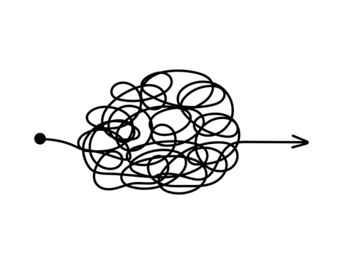
Context Engineering
Mind the Gap
Building an impressive AI Demo
has never been easier
✅
DEMO
LLM
ENV
… BUT …
turning the demo
in a reliable production-ready AI Product
remains challenging
❌
LLM
LLM
PRODUCTION
ENV
LLM
LLM
>
Pg: 7

Slide 8
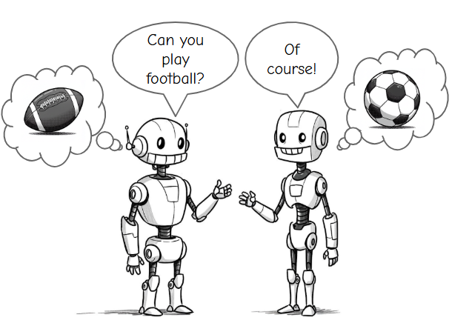
Context Engineering
Context is all you need
Most of the time when an agent is not performing reliably the underlying cause is not that the model is not intelligent enough, but rather that context has not been communicated properly to the model.
“The single biggest problem in communication is the illusion that it has taken place.”
George Bernard Shaw
📌 Communication is all you need by LangChain
>
Pg: 8

Slide 9
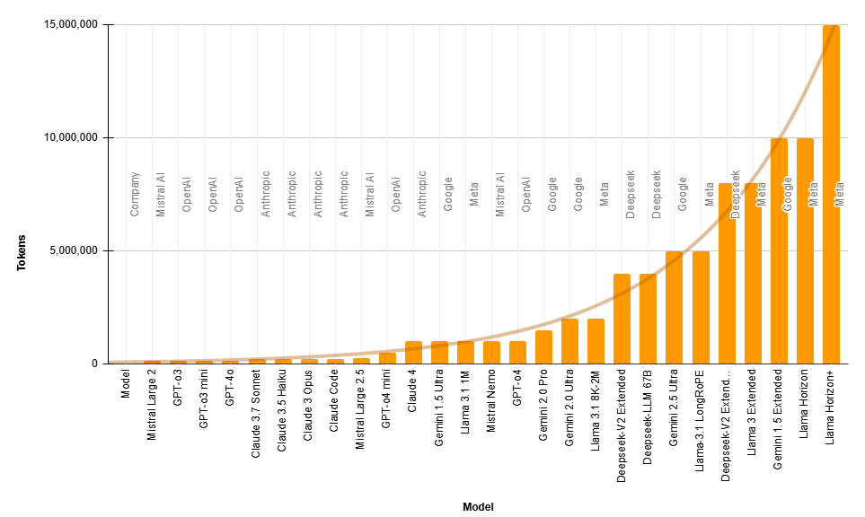




Context Engineering
Why large context windows are not enough
LATENCY
Large context means slow responses. Scanning all the tokens on every request takes time.
COSTS
Large context windows are expensive. More tokens means more money spent.
ACCURACY
1M
5M
15M
Claude 4 & GPT-04
Gemini 2.5 Ultra
Llama Horizon+
Large context can easily become poisoned, distracting, confusing, or conflicting.
📌 Will Growing Context Window Size Kill RAG? by Vishvambhar D.
>
Pg: 9
Notes:
1.5 M tokens is enough to load all seven Harry Potter books into the context window

Slide 10

Context Engineering
Context Engineering
Context
Engineering
Context engineering is the art and science of filling the context window with just the right information at each step of an agent’s trajectory.
Andrej Karpathy
Learning Processes
Memory
State
Knowledge
Context Window
Prompts
Retrieval Processes
📌 The rise of "context engineering" by LangChain
>
Pg: 10

Slide 11
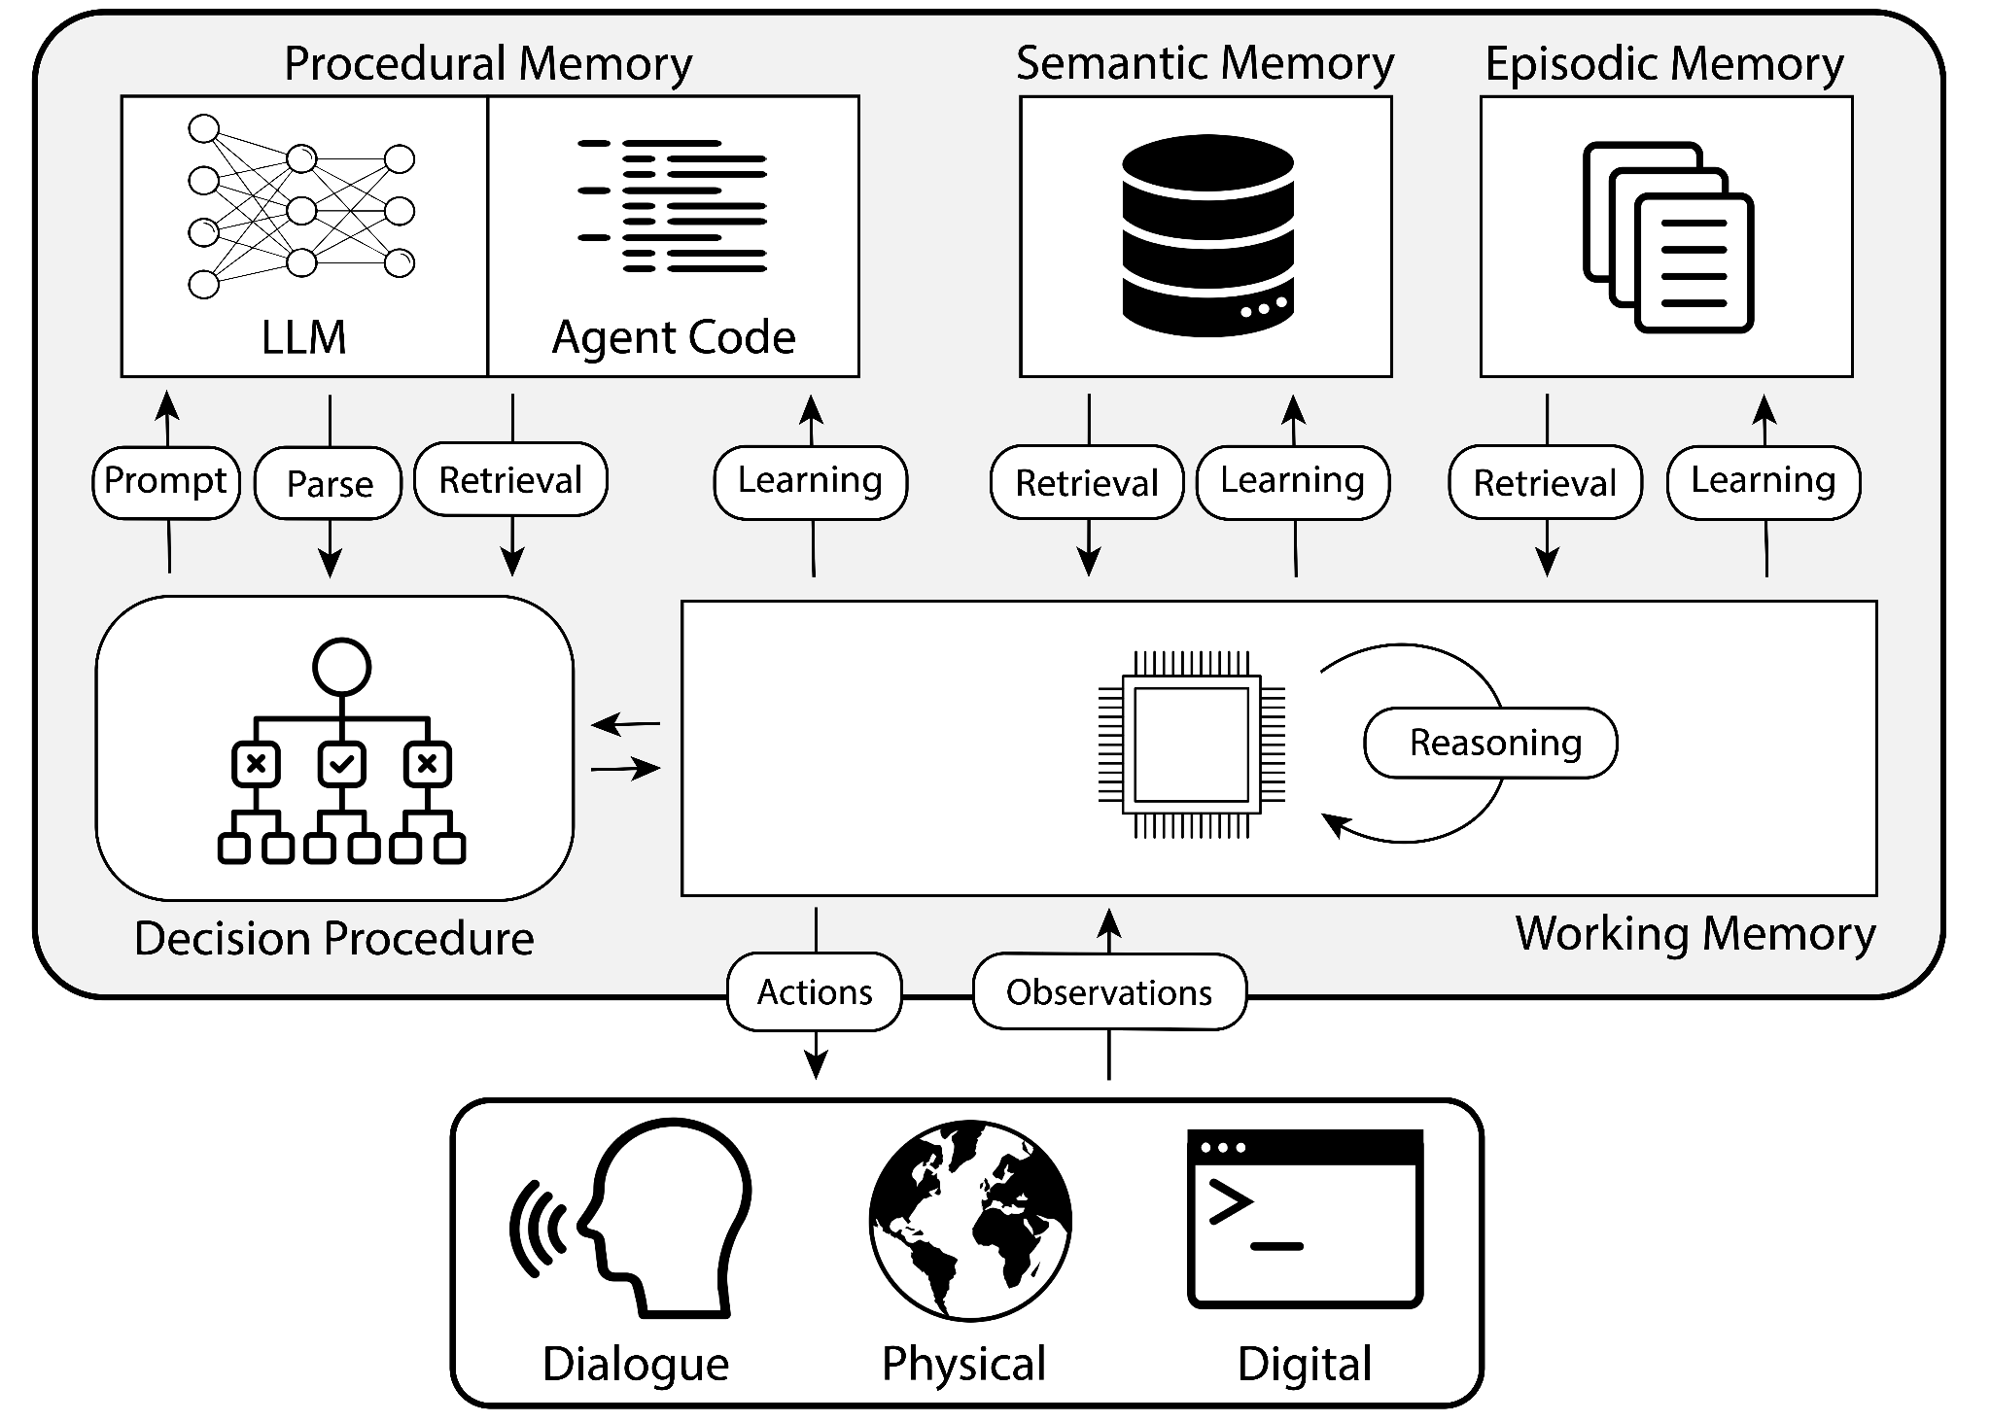
Context Engineering
Memory types
Know How
Know Why
Know That
CoALA is a framework to organize existing agents and plan future developments.
Under the CoALA framework, language agents explicitly organize information into multiple memory modules, each containing a different form of information.
These include short-term working memory and several long-term memories: episodic, semantic, and procedural.
Know When
Know What
📌 Cognitive Architecture For Large Language Agents by Y. Shunyu et al.
>
Pg: 11

Slide 12

Context Engineering
Information Architecture
Working
memory
Episodic
memory
Semantic
memory
Act
KNOWLEDGE
INTELLIGENCE
Short term
memory
Long term
memory
DATA
Understand
Reasoning
INFORMATION
KNOWLEDGE
Reasoning
Retrieval
Learning
Cognizing
Comprehend
INFORMATION
Tools
Processing
Collect
DATA
ENVIRONMENT
Sensing
>
Pg: 12

Slide 13


Context Engineering
Adhocracy creates an agentic mess
Customers have opened N tickets this week
AI
Customers have purchased N items this week
RAG
IA
IA
Siloed ad-hoc Context (aka Information Architecture)
IA
When they talk about customers, are they referring to exactly the same thing?
We have shipped N items to customers this week
AI
AI
>
Pg: 13

Slide 14
Context Engineering
Enterprise Information Architecture
We have shipped N items to customers this week
AI
IA
Customers have purchased N items this week
RAG
IA
RAG
IA
Customers have opened N tickets this week
Enterprise
RAG
IA
RAG
IA
>
Pg: 14

Slide 15
Section 02
Enterprise Knowledge Graph

Slide 16
EKG
Enterprise Knowledge Graph
Upper ontology
Reasoning
An enterprise knowledge graph is an elegant way to represent the entire information architecture in a single model that is
Shared
Formal
Computable
Enterprise Ontology
Domain ontology
KNOWLEDGE
Subdomain ontologies
Cognizing
INFORMATION
Processing
Physical Data
DATA
>
Sensing
Pg: 16

Slide 17



EKG / Data Plane
The power of modality
WTF!
👍
Monolithic Data Solution
Modular Data Solution
>
Pg: 17

Slide 18
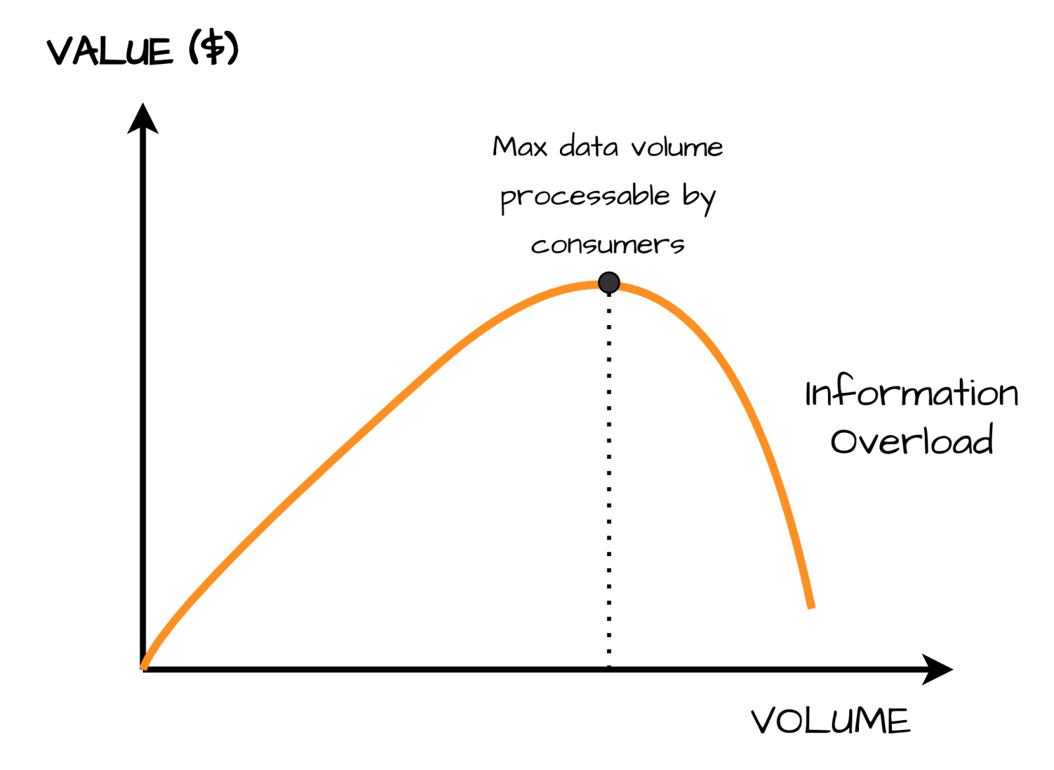
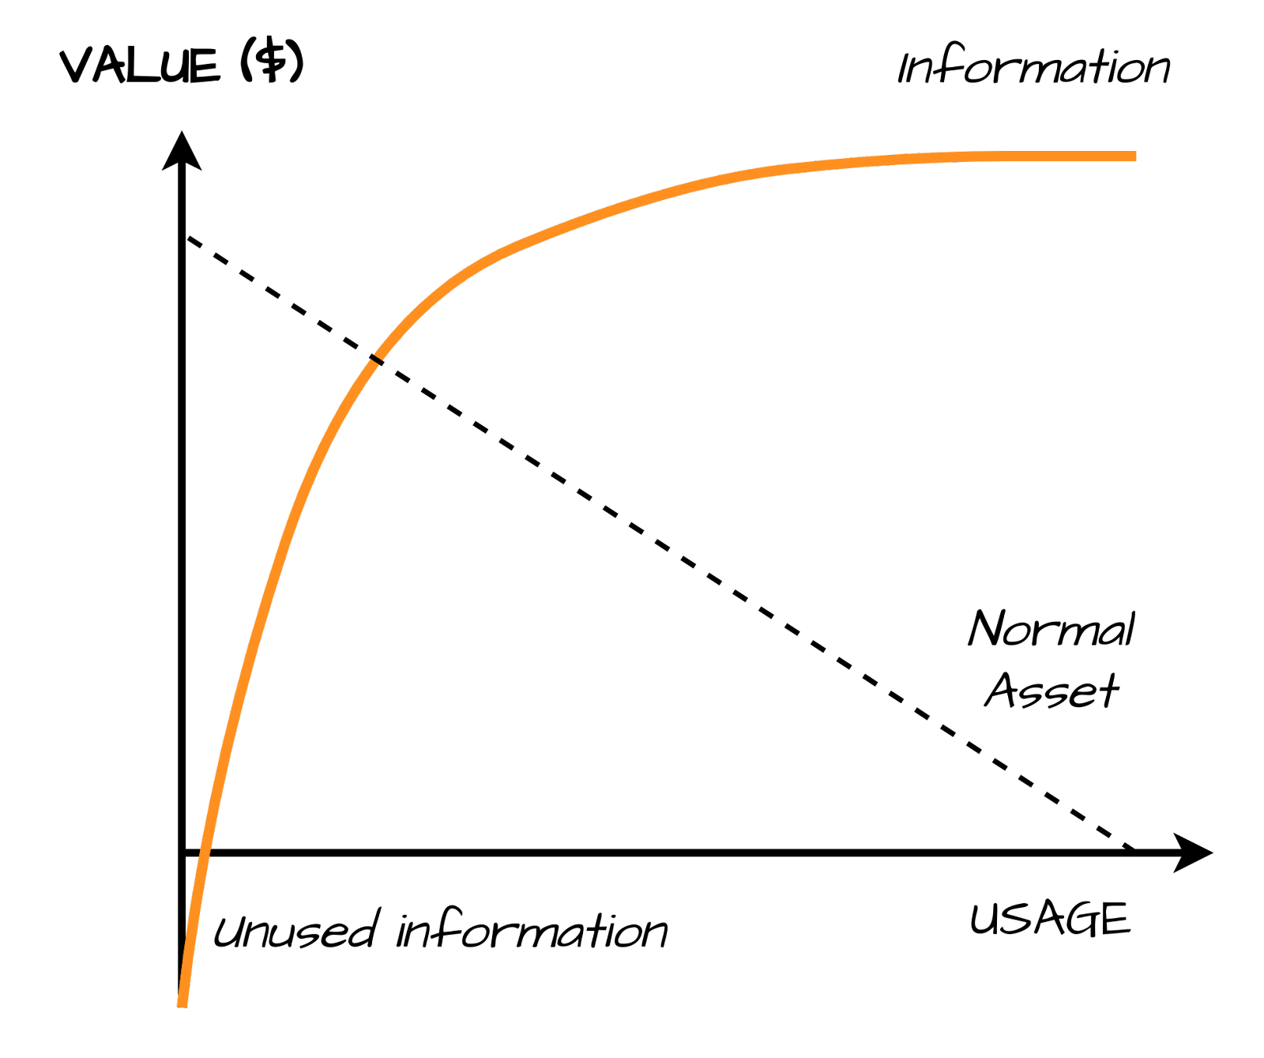
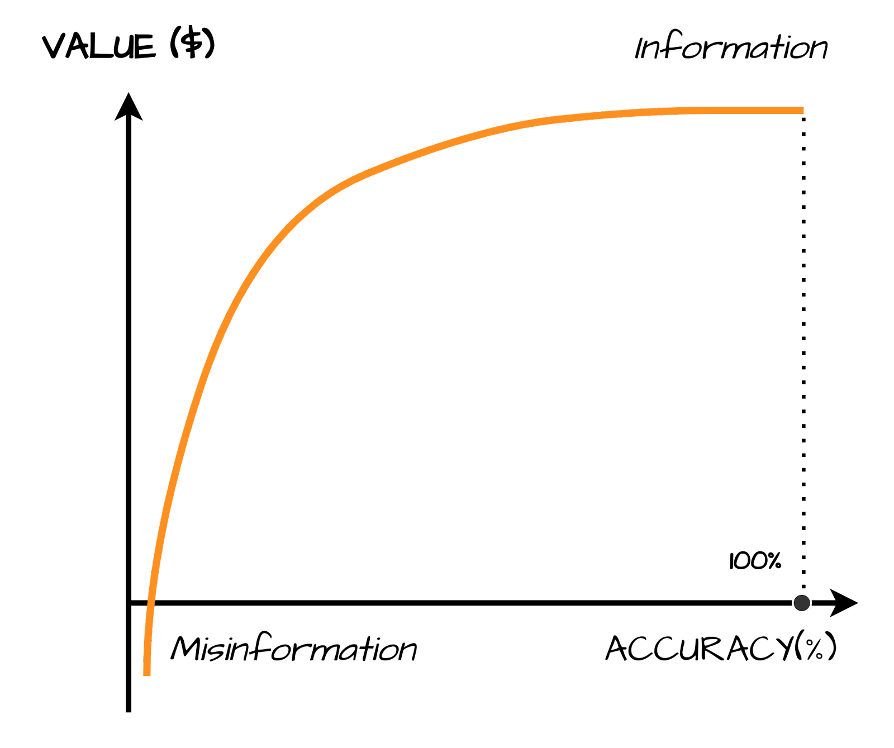
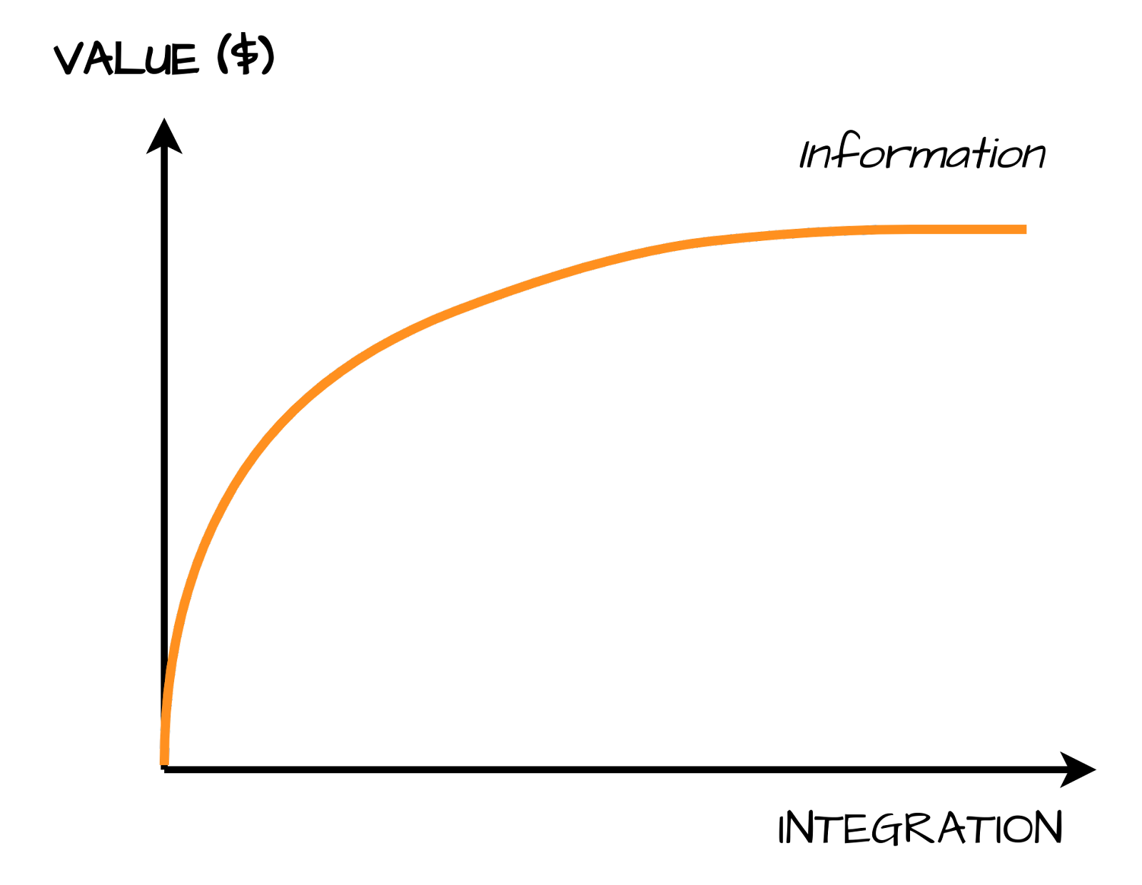
EKG / Data Plane
Data products
INTERFACES
Relevance
CODE
Reusability
Data Pipeline
DATA
METADATA
INFRASTRUCTURE
Accuracy
Composability
Storage
Compute
Identify and maintain
VALUE
Share and
multiply
>
Pg: 18

Slide 19
EKG / Information Plane
Metadata management shift-left
Federated Governance
Standardizes
INTERFACES
CODE
Data Contract
Data Pipeline
Promises
Producer
Populates
Accepts
& consumes
DATA
METADATA
Expectations
Consumers
Obligations
INFRASTRUCTURE
INTERFACES
CODE
Syntactic & technical interoperability
Data Pipeline
Storage
Compute
DATA
METADATA
INFRASTRUCTURE
Supports
Storage
Compute
Self-Serve Platform
>
Pg: 19

Slide 20
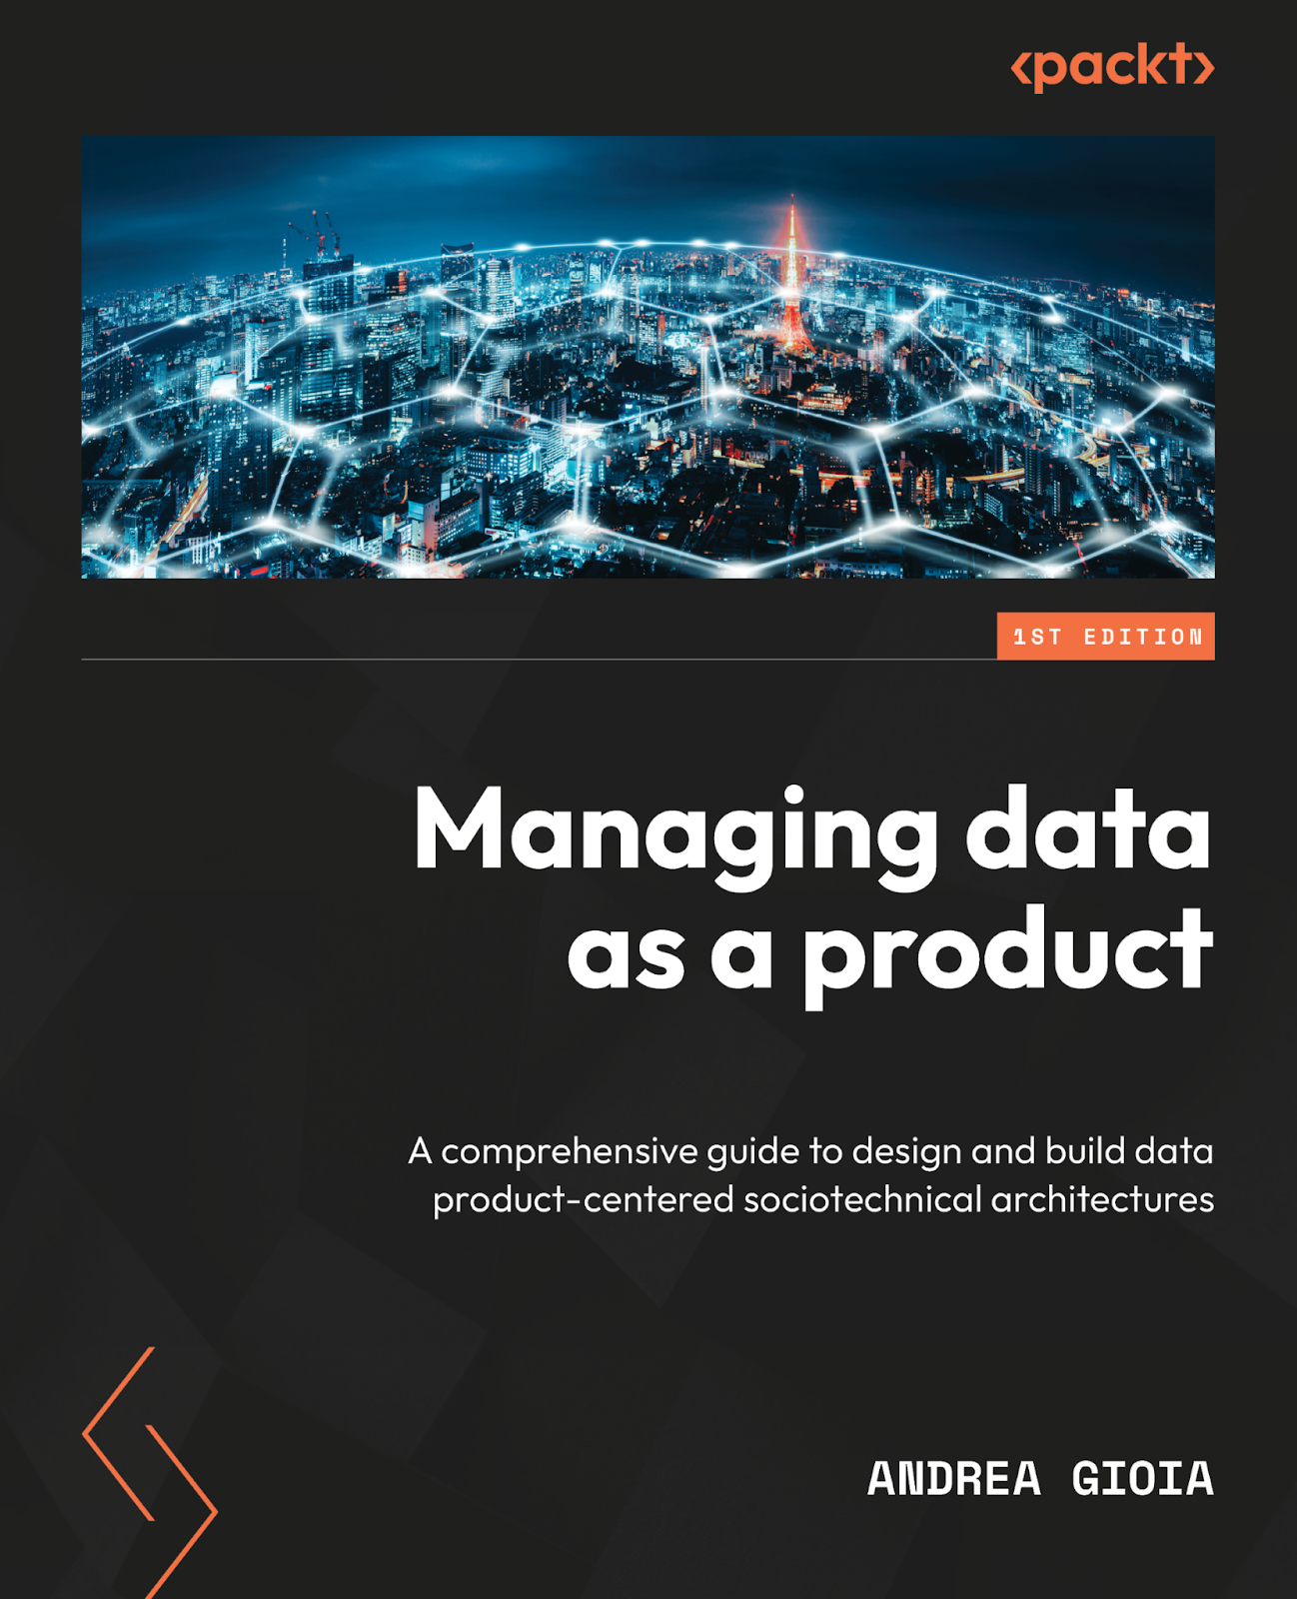

EKG / Data & Information Plane
Managing Data as a Product
Discovery ports
Information Plane
DATA PRODUCT
Data Product Team
Data Plane
Output ports
>
Pg: 20

Slide 21
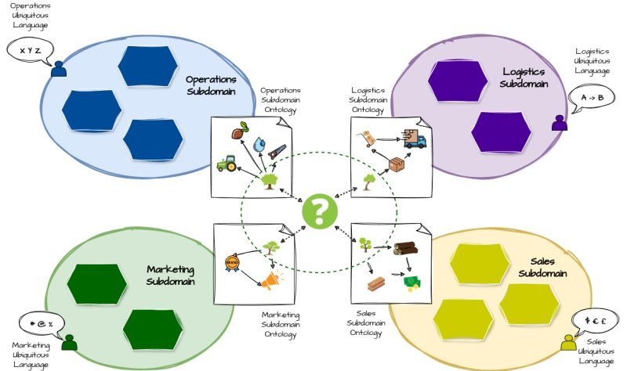
EKG / Knowledge Plane
Lost in translation
Different data assets are composable when they are interoperable at the following levels:
Technological
Syntactic
Semantic
Semantic interoperability is a major challenge.
>
Pg: 21

Slide 22








EKG / Knowledge Plane
Knowledge as a first-class citizen
I know the concept of “tree” because I know that …
Natural thing
Formalized into
… a tree is not a mineral
Grounded on
:type of
:type of
… a tree is a plant
Plant
Mineral
… a tree has a trunk
:type of
:type of
… a tree is not a bush
:has
… plus other facts that I have learned through experience or reasoning
Bush
Tree
Trunk
Implicit & Personal Knowledge Model
Explicit & Shared Knowledge Model
>
Pg: 22

Slide 23


EKG / Knowledge Plane
Semantic linking
Search INTO data
Search FOR data
Data Product
Data Product Descriptor
Enterprise Ontology
Ports
Apps
API
Dati
Exposes
Data Contract
Links to
Schema
infra
Internal Components
Data Plane
Information Plane
Knowledge Plane
Data Product Team
Modelling Teams
>
Pg: 23

Slide 24
Section 03
Knowledge Mesh

Slide 25
EKG / Knowledge Mesh
Federated conceptual modeling
Knowledge Mesh
X as a Product
X Domain Ownership
Computational Governance
Self-serve
Platform
Data Mesh
Socio
Technical
>
Pg: 25

Slide 26

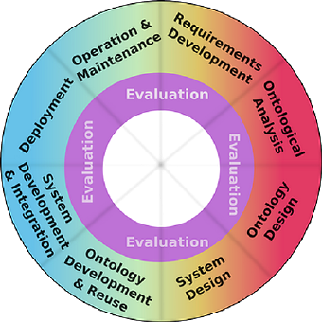
EKG / Knowledge Mesh
Knowledge as a Product
Enterprise Ontology
Ontology Lifecycle
Upper
Ontology
Domain
Ontologies
Subdomain
Ontologies
>
Pg: 26

Slide 27
EKG / Knowledge Mesh
Knowledge as a Product
Knowledge Domain Owner
Knowledge Domain Owner
Knowledge Domain Owner
A federated modeling team composed of representatives from each business domain manage the definition of the enterprise ontology.
This team can further organize by dividing responsibilities based on knowledge domains.
Ontology
Factual Data
Marketing
Business Domain Owner
Sales
EMEA
Business Domain Owner
Business Domains
Sales Nordics
Business Domain Owner
Operations
Business Domain Owner
Customer
Product
Order
Knowledge Domains
>
Pg: 27

Slide 28




EKG / Knowledge Mesh
Computational Governance
Federated Governance Team
Defines
Conforms to
GLOBAL
POLICIES
Domain
Ontologies
Enforces
Self-serve Platform
>
Pg: 28

Slide 29
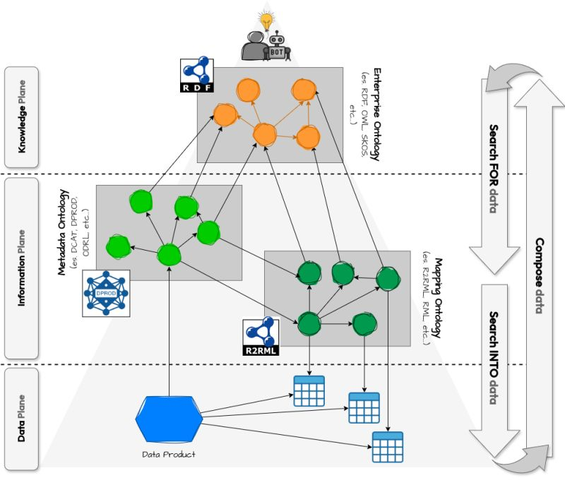
EKG / Knowledge Mesh
Self-serve Platform
Knowledge Product Developer Platform
KNOWLEDGE
Data Product Catalog
INFORMATION
DATA
Data Product Developer Platform
>
Pg: 29

Slide 30






EKG / Knowledge Mesh
Incremental & value-driven approach
Knowledge Graph
Knowledge Plane
Concepts + Relationships
Modeling Team
Ontology
Deploy
Knowledge Modeling
Data Management Solution
Business
Analysis
Business
Cases
Linking
Data Product(s)
Implementation
Information Plane
Data + Metadata
Deploy
Data products
Data Product Team
Iterate
>
Pg: 30

Slide 31

EKG / Knowledge Mesh
Final takeaway
There is no
reliable AI
without a
reliable IA
OUTSOURCE
INTELLIGENCE
INSOURCE
KNOWLEDGE
Artificial Intelligence
Information
Architecture
>
Pg: 31

Slide 32
Thank You

